Slide 1
Multi-Agent Coordinated Cops and Robber Game
Submitted by:
Shivam Kumar
24210094
Submitted to:
Prof. Jyoti Krishnan

Slide 2
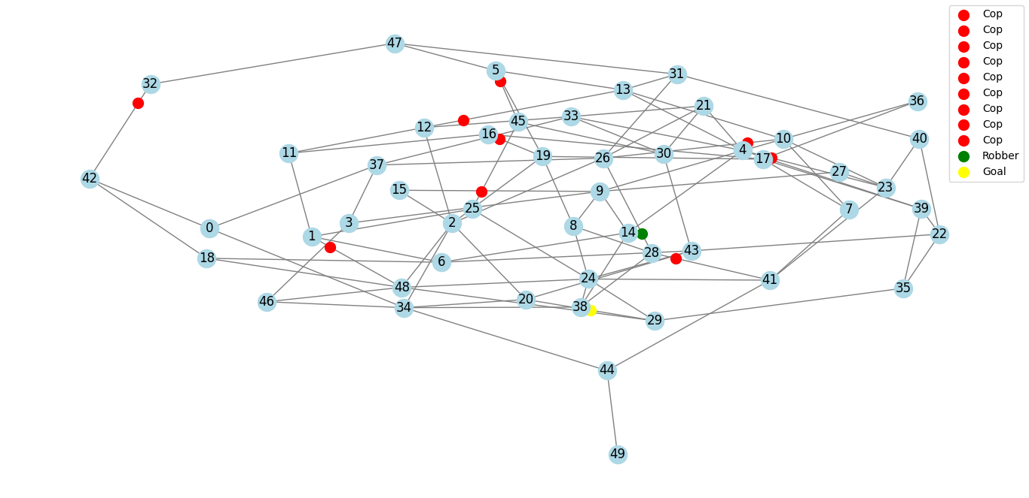
Introduction
Overview of the Game
A strategic pursuit-evasion game played on a randomly generated graph.
Objective: The cops try to capture the robber before they reach the goal.
Multi-agent system: Multiple cops coordinate using optimal strategies.
Robber's challenge: Navigate through the graph while avoiding capture.

Slide 3
Introduction
This game is a variant of the Cops and Robber Game, a well-known pursuit-evasion game played on a graph.
The goal is to analyze the optimal coordination strategies of multiple cops to capture the robber.
We simulate the game using graph theory, path-planning algorithms, and multi-agent coordination techniques

Slide 4
Rules of the Game
The game is played on a randomly generated connected graph.
There are one or multiple cops and one robber.
The robber moves first, selecting an adjacent edge.
Cops move simultaneously and optimally, aiming to capture the robber.
The game ends when:
The robber reaches the goal → Robber Wins.
The cops capture the robber by reaching the same edge → Cops Win.

Slide 5
Game Mechanics
How it works?
Robber: User selects next edge from adjacent edges
Cops: Move toward robber using A* pathfinding if robber is in their Voronoi region
Goal: Fixed edge; robber wins if reached
Game Ends: When cops catch robber (cop wins), or robber reaches goal (robber wins)

Slide 6
Model Setup
Graph generation:
User inputs: number of nodes (n) and graph type
Graph type: Sparse (e = 2n edges) or dense (e = max possible edges)
Player Strategies:
Robber: Manual moves (user input)
Cops: Voronoi regions partitioning A* chase using Manhattan distance heuristic
Notes:
Max edges = nc2

Slide 7
Analysis
Strategic Insights:
Robber’s strategy:
Move away from the nearest cop.
Head toward edges less likely to be occupied by cops.
By doing this try to reduce the distance between robber and goal
Cops’ strategy:
Cooperative pursuit via Voronoi partitioning and A* paths to catch the robber
Outcomes:
Robber wins if path to goal is at short distance and cop placement is suboptimal
Cops win if they trap robber between their regions

Slide 8
Findings:
Dense graphs favour cops (more edges = more interception points = dense cop regions)
Sparse graphs and a smaller number of cops favour robber (fewer paths = easier evasion)

Slide 9
Case: # nodes=22, # edges=44, #cops=3 -> Robber win in 3 steps
Move # | Robber Position | Cops Positions | Goal | Available Moves | Robber Action
0 | (0, 14) | [(10, 12), (6, 7), (3, 11)] | (3, 18) | {(13, 14), (3, 14), (14, 17), (0, 19), (0, 6), (0, 21), (4, 14)} | (0, 14) → (13, 14)
1 | (13, 14) | [(12, 15), (6, 7), (11, 13)] | (3, 18) | {(3, 14), (14, 17), (11, 13), (7, 13), (5, 13), (4, 14), (13, 15), (0, 14)} | (13, 14) → (3, 14)
2 | (3, 14) | [(3, 15), (6, 7), (3, 11)] | (3, 18) | {(13, 14), (14, 17), (3, 9), (4, 14), (3, 18), (0, 14), (3, 15), (3, 11)} | (3, 14) → (3, 18)
3 | (3, 18) | - | (3, 18) | {(13, 14), (14, 17), (3, 9), (4, 14), (3, 18), (0, 14), (3, 15), (3, 11)} | Robber wins!
4 | - | - | - | -

Slide 10
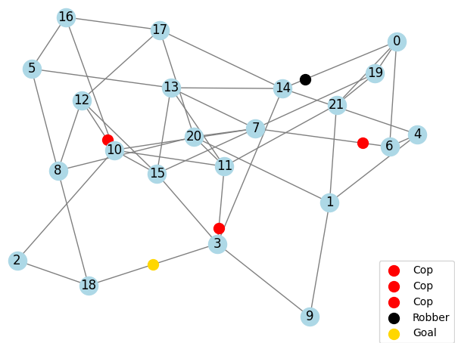
Visualization of Case Analysis (0/3)
Case Analysis : # nodes=22, # edges=44, #cops=3 -> Robber win in 3 steps
Robber’s Initial Position:
(0,14)
Cops Initial Positions:
(10,12)
(6,7)
(3, 11)

Slide 11
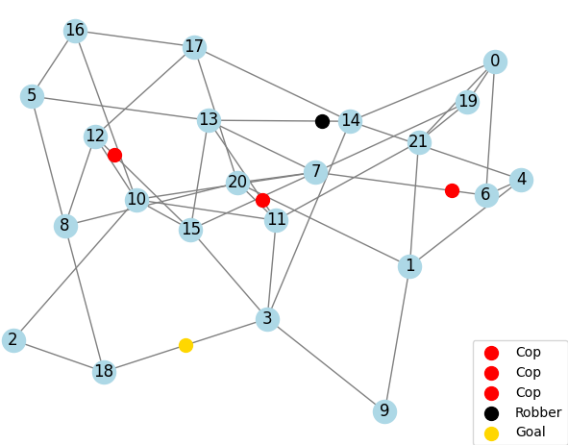
Visualization of Case Analysis (1/3)
Case Analysis : # nodes=22, # edges=44, #cops=3 -> Robber win in 3 steps
Robber’s Move:
(0,14) -> (13,14)
Cops Move:
(10,12) -> (12,15)
(6,7) -> NULL
(3,11) -> 11,13)

Slide 12

Visualization of Case Analysis (2/3)
Case Analysis : # nodes=22, # edges=44, #cops=3 -> Robber win in 3 steps
Robber’s Move:
(13,14) -> (3,14)
Cops Move:
(12,15) -> (3, 15)
(6,7)-> NULL
(11,13)-> (3, 11)

Slide 13

Visualization of Case Analysis (3/3)
Case Analysis : # nodes=22, # edges=44, #cops=3 -> Robber win in 3 steps
Robber’s Move:
(3,14) -> Robber Win
Cops Move:
(3, 15) -> NULL
(6, 7) -> NULL
(3, 11) -> NULL

Slide 14
Real-World Applications
Network Security: Modelling hacker evasion in communication networks
Robotics: Path planning for autonomous agents in pursuit scenarios
Urban Planning: Optimizing patrol routes in city graphs
Example: Drone surveillance systems tracking targets
Notes:
Max edges = nc2

Slide 15
Game Implementation
User inputs:
n = number of nodes
e = Choose sparse (edges = 2n) or dense graph (edges = nc2 = complete graph). Type s or d / sparse or dense
K = number of cops <= floor(n/2)
Graph visuals:
Red sphere -> Cop
Black sphere -> Robber
Yellow sphere -> Goal
Notes:
Max edges = nc2

Slide 16
Flow Chart
Start
User Inputs (n, e, k)
Generate Random Graph
Assign Cops, Robber, Goal
Game Loop
Draw Graph & Show Moves
Robber Moves (User Input)
No
Yes
Robber Reached Goal?
Robber Wins
No
Cops Move(A* Search)
Yes
Cop Caught Robber?
Cops Wins
No
End

Slide 17
Graph Structure & Design
We use NetworkX python module to generate a connected undirected graph with:
Nodes (vertices) representing locations.
Edges representing possible paths.
The graph is visualized using Matplotlib.

Slide 18
Algorithms Used
Algorithm | Purpose
A* Search | Cops use it to chase the robber
Voronoi Partitioning | Cops divide the graph into their respective regions
NetworkX Graph | Used to build the undirected graph based on user inputs
Notes:
Using Manhattan heuristic for A* search

Slide 19
Why A* Search Algorithm?
A* is an informed search algorithm used for shortest pathfinding.
It is chosen because:
It is fast in terms of computation therefore allows to play game in real-time.
It avoids unnecessary explorations, making it efficient for the cops.
The heuristic function used:
h(n)=Manhattan Distance(current position, target position)
Notes:
First explain how A* work. Also explain Dijkstra while speaking. Dijkstra:

Slide 20
Why Voronoi Partitioning Algorithm?
Voronoi Partitioning is used to divide the graph into territories controlled by each cop.
This ensures each cop is responsible for a distinct region, minimizing redundant movement.
Key Benefits:
Maximizes coverage: Each cop patrols its assigned zone.
Minimizes reaction time: Cops move towards robber in their region faster.
Reduces coordination complexity: Instead of all cops chasing the robber blindly, each cop protects its region optimally.
Why Not Other Methods?
Random patrols lack coordination and may leave gaps.
Uniform spread doesn’t work well on irregular graphs.
Voronoi adapts dynamically to graph structure.

Slide 21
Why Graph Shortest Paths needed?
Shortest path algorithms ensure the cops take the fastest route to the robber.
We use NetworkX’s shortest path functions to:
Determine which cop is closest to the robber.
Plan optimal movement toward the robber's edge.
Why Not Greedy Movement?
A naive greedy approach may lead to traps or longer paths.
Shortest paths guarantee efficiency while considering obstacles.
Alternative Algorithms Considered:
Dijkstra's Algorithm (too slow for large graphs).
Breadth-First Search (BFS) (works but less efficient than A*).
Floyd-Warshall (too computationally expensive).

Slide 22
Logical Implementation of A* Search
How A Works in Our Game?*
Graph Representation:
The game graph is represented as an undirected weighted graph using NetworkX.
Each edge is a valid movement path.
Heuristic Function:
A* requires a heuristic function to estimate distance.
We use Manhattan Distance (sum of absolute differences in node indices).
h(edge1, edge2) = |edge1[0] - edge2[0]| + |edge1[1] - edge2[1]|
Priority Queue & Pathfinding:
A priority queue stores potential paths.
We expand the cheapest node first (lowest cost + heuristic).
If a path to the robber's edge is found, it is returned as the cop’s chase route.

Slide 23
Logical Implementation of Voronoi Partitioning
How Voronoi Works in Our Game?
Graph Partitioning:
The graph is split into regions, each controlled by a cop.
Each node belongs to the closest cop based on the shortest path.
Assigning Territories to Cops:
For each node, we determine which cop can reach it the fastest using NetworkX shortest path length.
The cop with the shortest distance to a node claims that node.
Preventing Overlaps:
Each cop's region is separate to avoid redundant chasing.
A cop only intervenes in its assigned area.

Slide 24
Proof of Cops Playing Optimally in Multi-Agent System (1/4)
1. What does playing optimally mean?
The cops’ goal is to capture the robber in the shortest time possible.
They divide the search space efficiently using Voronoi Partitioning.
Each cop follows an optimal pursuit strategy using A* search.
2. Why is this strategy optimal?
Minimum Distance to the Robber
The Voronoi partitioning ensures each cop controls its closest region.
This reduces redundant movements and prevents multiple cops from chasing the same region.

Slide 25
Proof of Cops Playing Optimally in Multi-Agent System (2/4)
2. Why Is This Strategy Optimal?
A* Guarantees Shortest Path
A* chooses the fastest route for each cop to move towards the robber.
The heuristic function guides the cops towards their target efficiently.
Dynamic Adaptation to the Robber’s Moves
Each cop recalculates its path after every robber move.
Cops switch strategies if the robber moves into another cop's region.

Slide 26
Proof of Cops Playing Optimally in Multi-Agent System (3/4)
3. Mathematical Justification
Graph-Theoretic Approach:
Let G(V, E) be the game graph.
Let R(t) be the robber’s edge at time t, and C_i(t) be cop i’s position at time t.
The chasing strategy ensures that for each time step:
d(Ci(t+1),R(t+1))≤d(Ci(t),R(t))
Meaning the cop always moves closer to the robber.
Optimal Capture Condition:
If a cop reaches the robber’s edge, capture happens.
Given A search is optimal*, the first cop to reach the robber does so in the shortest possible time.
Therefore, the cops always play optimally given the robber's moves.

Slide 27
Proof of Cops Playing Optimally in Multi-Agent System (4/4)
4. Why This Strategy Works in Any Graph?
We find the best move in the graphs using A*.
Voronoi ensures optimal territory division in any connected graph.
If the robber is trapped between regions, cops close in optimally.

Slide 28
Let’s play the game

Slide 29
References
Gibbons, R. (1992). Game Theory for Applied Economists
NetworkX Documentation: https://networkx.org
A* Algorithm: Cormen et al., Introduction to Algorithms
Matplotlib Documentation: https://matplotlib.org

Slide 30
Thank You

